Slide 1
Improving Canny Edge Detection using edge-preserving filters
SeyedPooya Soofbaf

Slide 2
What is Canny?

Slide 3
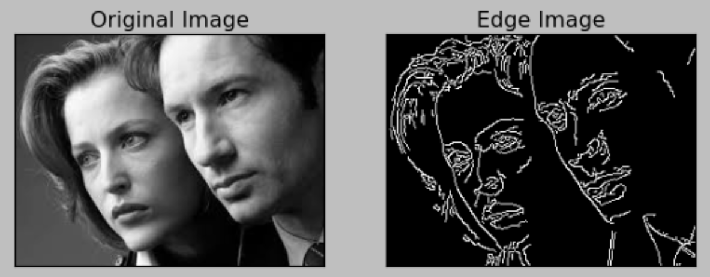
Canny Edge Detection
Canny Edge Detection is an edge detection algorithm that was developed by John F. Canny in 1986.
The Canny Edge Detection algorithm works by first smoothing the image with a Gaussian filter to reduce noise (preprocessing).
It then computes the gradient of the image to find edges and applies non-maximum suppression to thin out the edges.
Finally, it applies hysteresis thresholding to determine which edges should be kept.

Slide 4
Preprocessing

Slide 5
Preprocessing
Gaussian filter
The Gaussian smoothing in the Canny edge detector fulfills two purposes:
First it can be used to control the amount of detail that appears in the edge image
Second, it can be used to suppress noise.

Slide 6
Why not edge-preserving filters?

Slide 7
Preprocessing
Edge-preserving Filters
An edge-preserving filter is a type of image filter that aims to smooth an image while preserving its edges.
Traditional smoothing filters such as the Gaussian filter can blur the image and lead to a loss of important details, especially at the edges.
In contrast, edge-preserving filters are designed to suppress noise and smooth the image while preserving the sharp transitions between areas of different intensity or color, which are typically associated with edges.

Slide 8
Preprocessing
Edge-preserving Filters
Bilateral filter
The bilateral filter takes into account both the spatial distance between pixels and the difference in intensity values.
It uses two Gaussian functions to weight the spatial and intensity differences between pixels (Distance & Intensity)
By combining these two functions, the bilateral filter preserves edges while smoothing the rest of the image.

Slide 9
Preprocessing
Edge-preserving Filters
Median filter
Replaces the value of a pixel with the median value of its neighboring pixels.
The size of the neighborhood is specified by a kernel or window, which slides over the image pixel by pixel.
For each pixel, the values of the neighboring pixels within the kernel are sorted, and the median value is taken as the new value for the pixel being filtered.

Slide 10
Preprocessing
Edge-preserving Filters
Guided filter
Is a type of edge-preserving filter that uses guidance information to smooth images while preserving edges.
It is a non-linear filter that operates by computing the weighted average of pixels in a local neighborhood.
The weights are determined by the guidance image, which provides information about the edges in the original image.

Slide 11


Implementation

Slide 12
Evaluation and Results
Gaussian filter is really powerful!!!
In some cases it worth trying edge-preserving filters
Some improvement in segmentation metrics results
Adapted Rand Error
Variation of Information

Slide 13
Thank You!

